Slide 1
Lecture – 21

Slide 2
Communication Methods
Intrasystem Communication:
Occurs within a single computer system.
Implemented by bus.
Transmission is parallel.
Intersystem Communication:
Involves communication over much longer distances.
Realized by a variety of physical media.
Transmission is serial.

Slide 3
Buses
Reading Assignment

Slide 4
Bus Arbitration
Several master or slave units connected to a shared bus may request access to the bus at the same time. A selection mechanism called bus arbitration is required to enable the current master called bus controller to decide among such competing requests.
Three arbitration scheme:
Daisy Chaining
Polling
Independent Requesting

Slide 5
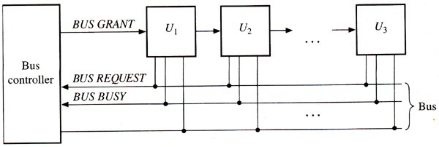
Daisy Chaining

Slide 6
Daisy Chaining
Advantages:
It requires very few control lines.
Its arbitration scheme is very simple and fixed.
It can be used with unlimited number of bus units.
Disadvantages:
A unit’s priority cannot be changed under program control.
A high-priority unit can lock out a low-priority device.
If a unit U_{i} is unable to propagate the BUS GRANT
signal, then no U_{j} where j>i can gain access to the bus.

Slide 7
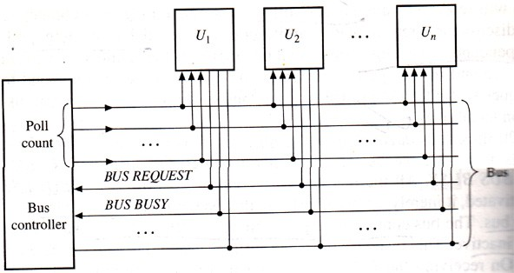
Polling

Slide 8
Polling
Advantages:
The selection priority can be altered under software control.
A failure in one unit does not affect the other units.
Disadvantages:
It requires more control line.
The number of units that can share the bus is limited by the addressing capability of the poll-count lines.

Slide 9
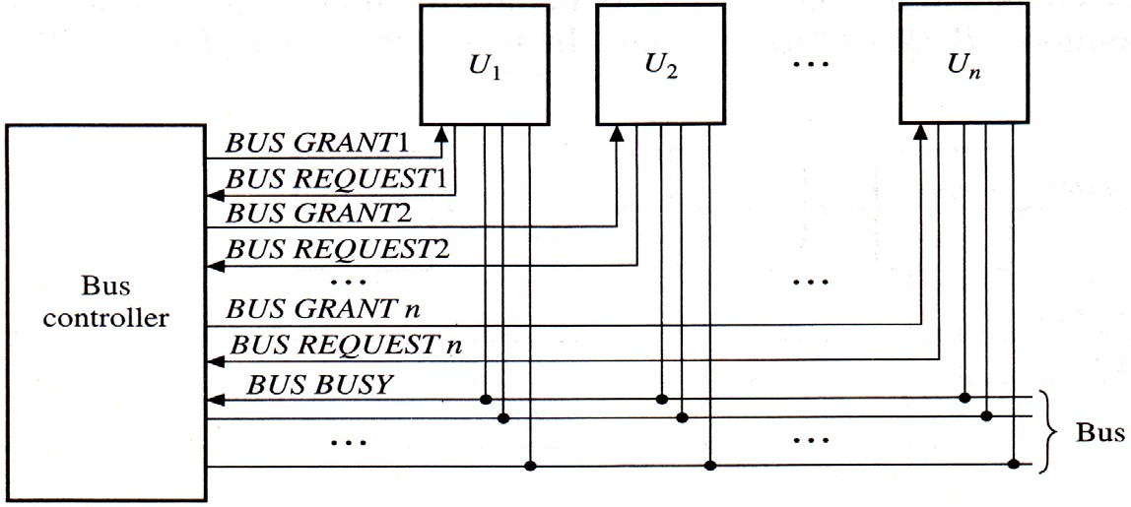
Independent Requesting

Slide 10
Independent Requesting
Advantages:
The bus controller can respond rapidly to requests for bus access.
The bus controller unit determines priority, which is programmable.
Disadvantages:
It requires n BUS REQUEST and n BUS GRANT lines for n units. In contrast, daisy chaining requires two such lines, while polling requires approximately log₂n lines.

Slide 11
IO Control Methods
Three control methods:
Programmed IO
Direct Memory Access (DMA)
Interrupt

Slide 12
Programmed IO
Programmed IO requires that all IO operations be executed under the direct control of the CPU.
Every data-transfer operation involving an IO device requires the execution of an instruction by the CPU.
The transfer is between two programmable registers: one is a CPU register and the other attached to the IO device.
The IO device doesn’t have direct access to main memory.
A data transfer from an IO device to M requires the CPU to execute several instructions.

Slide 13
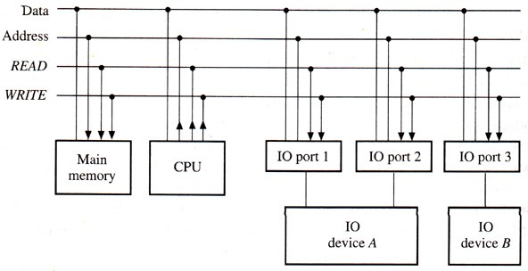
Memory-mapped IO

Slide 14
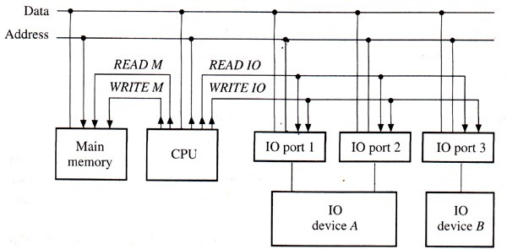
IO-mapped IO

Slide 15
Programmed IO
Advantages:
No special hardware needed.
The scheme is very simple.
Disadvantages:
The speed with which the CPU can test and service IO devices limits IO data transfer rates.
The time that the CPU spends testing IO device status and executing IO data transfers can often be better spent on other tasks.

Slide 16
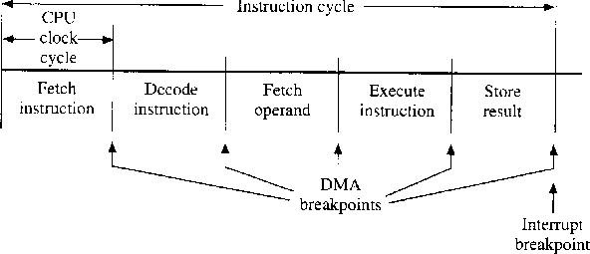
DMA and Interrupt Breakpoints

Slide 17
Direct Memory Access (DMA)
A DMA request by an IO device only requires the CPU to grant control of the memory (system) bus to the requesting device.
The DMA controller is provided with an interrupt capability, in which case it sends an interrupt to the CPU to signal the end of the IO data transfer.

Slide 18
Interrupt
An interrupt asks the CPU to interrupt service program.
begin executing an
The interrupt program performs tasks such as initiating an IO operation or responding to an error encountered by the IO device.
The CPU responds to interrupts only between instruction cycles.

Slide 19
Interrupt
The CPU transfer of
responds control
to an interrupt request by a to an interrupt handler
like
subroutine call. The following steps are taken:
The CPU identifies the source of the interrupt.
The CPU obtains the memory address of the required interrupt handler.
The PC and other CPU status information are saved.
The PC is loaded with the address of the interrupt handler. Execution proceeds until a return instruction is encountered.

